Slide 1
Discussion & Lecture Session Sound & Recording Check
Remote participants:
Log into Join.me
Announce yourself and provide your name on the phone and/or in the chat session
For Screen Sharing utilize your computer
For conference call audio utilize your computer speakers and microphone OR dial into the session with your mobile phone
Onsite participants:
Sit in a good spot near the “speaker phone” if possible
Optionally sign into Join.me… but make sure that your microphone and speakers are muted/off
Test recording by starting recording and then stop recording after a few seconds
Check recording sound when video is released by Join.me

Slide 2

Software Engineering Discussion, Lecture, & Lab Eric Pogue
Agenda for Wednesday, January 15th at 2pm CT
Welcome!
Friendly Conversation Topic
Introductions*
Prework
Course Overview
Course Format – Flipped & Agile
Syllabus
Sprint Planning
Assignment
Lab
Discussion & Questions welcome at any time… please be present with no phones or email during our time together

Slide 3
Welcome!
This is:
Software Engineering (cpsc-44000)
WF 2-4:30pm CT
And I am:
Eric Pogue
Welcome to those who:
Were able to attend in person… Thank you!
Remote participants… Welcome!
Will be watching the session recording later

Slide 4
Welcome Announcement

Slide 5
Friendly Conversation Topic

Slide 6

Today’s Friendly Conversation topic

Slide 8
Introductions – Blackboard DB*

Slide 9
Today’s Introductions – Name plus Fun Fact
For your introduction include:
Preferred Name and Full Name
A score of 0 to 5 describe your programming experience with:
0 being “I’ve never seen a line of code”
1 being “This is my first college level programming class”
3 being “I’ve had a couple of programming classes”
5 being “I’m ready to graduate and get and entry level programming job”
Be ready to introduce yourself and to share an interesting fact about yourself
Anything else you would like to add
Notes:
Hand out name tags and introduction forms before Syllabus Overview

Slide 10
Introductions*
Full and Preferred Name:
Eric Pogue
Eric, Mr. Pogue, or Professor
Family, Home, College background:
Married with five children, relocated from Davenport, IA to Chicago area a couple years ago
Undergraduate in CS and Masters in Business… teaching online/evening for many years
Programming experience:
Decades in the industry as a developer, architect, project manager, division manager, and vice president of various software development organizations
Part of many teams that have delivered products to ten’s of millions of customers globally
Parsons Technology, Intuit, The Learning Company, Jasc Software, and John Deere
… and most recently working on a startup product in the Architecture field with my oldest son

Slide 11








Slide 12
Welcome & Introductions
Likely programming environment
Personal Laptop, Windows 10 (moving to MacOS), Chrome browser, and Visual Studio Code text editor… looks like I will be learning some Ubuntu Linux over the next few weeks
Hobbies:
Wilderness Canoeing & Camping (Quetico) and Triathlons
Top two or three things that you would like to get out of this class
help each of you be successful in this class
explore software development Architecture and Design processes and techniques together and motivate you to look deeper
and for us to find a little enjoyment and fun along the way*
… oh yes, and it would be wonderful if I could help you build something that made you proud during the semester
Fun Fact:
At one point I had the very dubious “honor” or being the most traveled John Deere employee to India with 40+ trips over a 5-6 year period while setting up the 400+ person John Deere Technology Center – India application development organization.

Slide 13
Prework

Slide 14
Course Overview
Software Engineering (cpsc-44000)
Part of our Lewis University Computer Science program [link]
Computer Science (BS) [link]
Your feedback is greatly appreciated
Notes:
I taught this course as an onsite course several years ago.
Most of the topics in the course relate to “Everything beyond writing code required to deliver a quality software product.”
Therefore the focus is on Development Process and Architecture… and Business Organization & Processes
One of the challenges is that our backgrounds in writing software is inconsistent so it’s difficult for us to practice “everything beyond writing software” without knowing how to write the software in a consistent way
Final thought… much of the “everything beyond code” that we do is because it is hard to effectively work in teams…
Teach as-is and then update the course content for next semester… decided to live large and make the changes now.

Slide 15
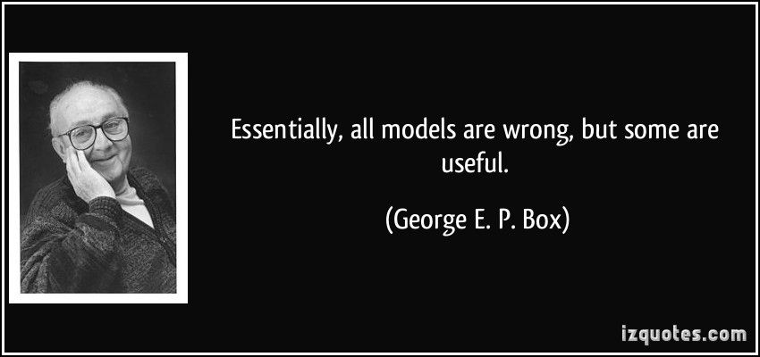
Models

Slide 16
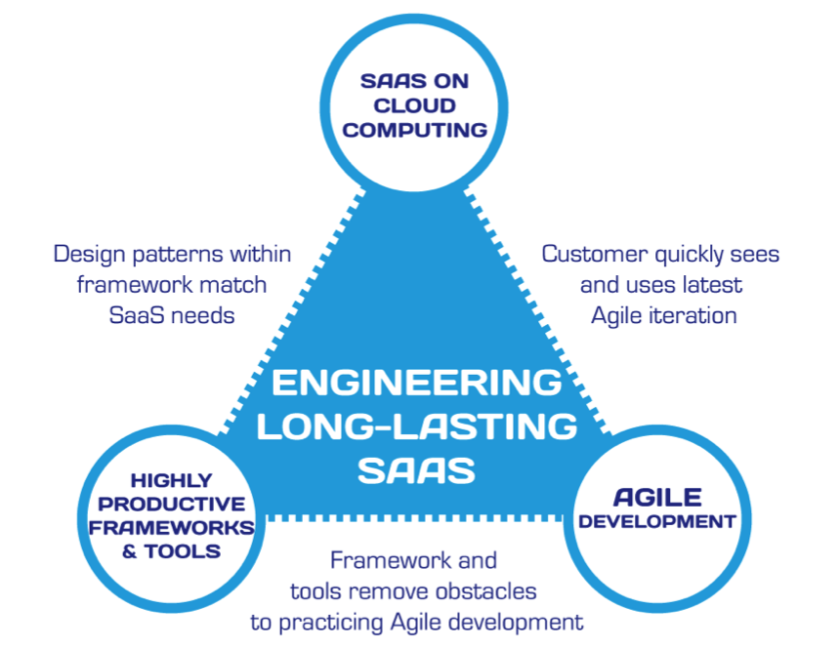
Hosting Technology: Cloud & Software as a Service (SaaS)…
People: Organizations, Domain Knowledge, Customers, Business Process…
The
Virtuous Triangle
Process: Agile, Requirements, Project Management, Prioritization, Portfolio Management, Metrics…
Productivity Technology: Configuration Management, Source Code Management, Automated Testing…

Slide 17
Syllabus

Slide 18
Course Format – Flipped & Agile

Slide 19
Blended Learning & Flipped Classroom form "Blended Learning & Flipped Classroom" video

Slide 20
Blended Learning & Flipped Classroom form "Blended Learning & Flipped Classroom" video

Slide 21
Course Format – Agile

Slide 22
Agile Manifesto
“We are uncovering better ways of developing software by doing it and helping others do it. Through this work we have come to value:
Individuals and interactions over processes and tools
Working software over comprehensive documentation
Customer collaboration over contract negotiation
Responding to change over following a plan
That is, while there is value in the items on the right, we value the items on the left more.”
Notes:
This was kind of “hippy-ish” and egalitarian in its day… quite controversial in its day
“Everyone is a team member and is responsible for the work getting done”… we don’t need no titles or positions… self-organizing… we will make our own commitments… transparency (let’s share the information)… flexible/organic teams, organic architecture (minimal documentation/standards)… no contracts (let’s talk it over)
The flip side:
We will actively and voluntarily play important roles on our team
The rules (rituals) that we do have… we WILL follow
We will create, demo, and release working software/products
We will utilize practical processes, tools, documentation, and planning
When we make commitments, we will live up to those commitments… as a team (“No winners on a losing team, and no losers on a winning team”)
We will be responsive and continuously improve (Retrospectives)
We will be transparent with how WE work and share our information

Slide 23
Agile Manifesto
Agile Team Commitments:
Everyone is a team member and is responsible for getting the work done (we don’t need titles and positions)
We will actively and voluntarily play important roles on our team
The rules (rituals) that we do have… we WILL follow
We will create, demo, and release working software products
We will utilize practical processes, tools, documentation, and planning
When we make commitments, we will live up to those commitments… as a team (“No winners on a losing team, and no losers on a winning team”)
We will be responsive and continuously improve (Retrospectives)
We will be transparent with how WE work and share our information
Notes:
Agile Team Commitments
Everyone is a team member and is responsible for the work getting done
we don’t need no titles or positions
self-organizing
we will make our own commitments
transparency (let’s share the information)
flexible/organic teams, organic architecture (minimal appropriate documentation/standards)
no contracts (let’s talk it over)

Slide 24

Scrum Discussion from Introduction to Scrum - 7 Minutes YouTube video [link]
Notes:
Other roles exist like developer, tester, etc.
Individuals are expected to play multiple roles as needed.
Three Artifacts:
Product Backlog
User Stories
Burndown Chart
Three Rituals:
Sprint Planning
Daily Scrum
Sprint Review or Retrospective

Slide 25
Scrum Roles, Artifacts, and Rituals
Three Roles:
Product Owner
Scrum Master
Team Member
Three Rituals:
Sprint Planning*
Daily Scrum
Sprint Review or Retrospective
Three Artifacts:
Product Backlog
User Stories
Burndown Chart

Slide 26

Scrum Process & Roles – Sprint Planning
By Dr ian mitchell - Own work, CC BY-SA 4.0, Link

Slide 27
Sprint Planning
Notes:
Start with course schedule.

Slide 28
Assignment for Next Class
All sprint 1 / week 1 activities & assignments are due Sunday night*
Sprint 2 content and prework will be made available by Monday
Notes:
* You have a grace period of 6 hours until 6am CT Monday morning to submit assignments.

Slide 29
Wrap-up and Final Questions/Comments

Slide 30
Break & End of First Recording

Slide 31
Lab
As A Group:
Optionally Complete DB*
Optionally Complete DB1
Review & Discuss Architecture and Tool Choices
Review Cloud Hosting Choices
Demonstrate how to access course material with Git & GitHub

Slide 32
DB*: Instructions
As A Group:
Start Recording
Review DB*
Provide your perspective
Actively participate in ongoing discussion
Past the link to the DB* video in the DB* response area and receive full credit

Slide 33
DB1: Software Lifecycle Models
As A Group:
Start Recording
Review DB*
Provide your perspective
Actively participate in ongoing discussion
Past the link to the DB* video in the DB* response area and receive full credit

Slide 34
Architecture and Tool Choices
There are many very good Language / Framework / Hosting options available including:
Ruby / Rails / Rack
JavaScript / Express / Node.js
Java / Spring / Tomcat
.NET / ASP.NET / IIS (Internet Information Services)
We will be focusing on the JavaScript / Express / Node.js combination with the possible addition of Bootstrap and TypeScript.

Slide 35
Cloud Hosting Choices
There are also many very good cloud hosting services available including:
Amazon AWS
Microsoft Azure
Google App Engine
cloud9
GoDaddy
We will be focusing on the Microsoft Azure.

Slide 36
End of Session & Recordings

Slide 37
Backup Slides

Slide 38


Model-View-Controller (MVC)
Diagram of interactions within the MVC pattern.
Model–view–controller is an architectural pattern commonly used for developing user interfaces that divides an application into three interconnected parts. This is done to separate internal representations of information from the ways information is presented to and accepted from the user.[1][2] The MVC design pattern decouples these major components allowing for efficient code reuse and parallel development.
Traditionally used for desktop graphical user interfaces (GUIs), this architecture has become popular for designing web applications and even mobile, desktop and other clients.[3] Popular programming languages like Java, C#, Ruby, PHP have MVC frameworks that are used in web application development straight out of the box

Slide 39
People, Process, and Technology
Software Engineering:
People: Teams, Optimism, Engagement, Ambition, Dedication, Leadership, Skills, Experience, Domain Knowledge… “the Business”
Process: Waterfall/Iterative/Agile, Portfolio Management, Project Management, Funding, Prioritization, Metrics…
Technology: Usability, Architecture, Configuration Management, Cloud Hosting, Scriptable Infrastructure, Source Code Management, Automated Testing…
Notes:
Eric’s View

Slide 40
The Right-eous Triangle of Software Development
People & Organizations
Technology & Tools
Process & Roles

Slide 41
The Right-eous Triangle
Of Software Development

Slide 42
The Right-eous Triangle of Software Development
People & Organization
Technology & Tools
Process & Roles

